Slide 1





Intelligent Solutions
ODOO RETAIL
INVENTORY PROJECT
Supervised By : DR. Elwy Rady

Slide 2



Our Team
Chart of the project
Overview
Business Analysis
Challenges
Solution and objectives
Implementation
Conclusion
Q&A
OUTLINES

Slide 3






INTELLIGENT SOLUTIONS
Mohga Mohamed
Mohamed Samir
Heba Salah
Moustaf Ehab
Moustafa Mohamed
Team leader
Eman Ibragim
Osama Ahmed
Sondos Gharib

Slide 4

Retail
Inventory Project
1-Business Analysis
2-Challenges
Retail Inventory Project
4-Implementation
3-Soution and objectives

Slide 5


Overview of the project
Business Plan
Business Proposal
Implement Odoo for retail inventory to enhance accuracy, streamline operations, and improve customer satisfaction. The project includes thorough market analysis, resource allocation, a phased implementation plan, and risk management strategies. Expected ROI from reduced costs and increased efficiency will drive stakeholder support a
This proposal outlines the implementation of Odoo for retail inventory management to optimize stock control, enhance operational efficiency, and improve customer satisfaction. Key components include a phased deployment plan, training for staff, and ongoing support. The project aims to achieve significant cost savings and boost overall business performance.

Slide 6


Business Analysis
The business analysis identifies the need for Odoo in retail inventory management to address inefficiencies and inaccuracies. Key benefits include real-time tracking, streamlined processes, and improved reporting. Analyzing current workflows highlights gaps, while stakeholder feedback ensures alignment with business goals, paving the way for successful implementation and adoption.

Slide 7
Challenges
Inefficient inventory management leading to stockouts and overstocking.
Lack of real-time data affecting decision-making.
Manual processes causing delays and increasing human error.

Slide 8
Solution and objectives
The solution involves implementing Odoo to automate and optimize retail inventory management. Objectives include enhancing inventory accuracy, reducing stock discrepancies, improving order fulfillment speed, and providing real-time reporting. This will lead to better decision-making, increased operational efficiency, and elevated customer satisfaction, ultimately driving business growth and profitability.

Slide 9



Implementation phases
Phases 1
Phasee 2
Needs Assessment: "We began by assessing our current processes and identifying specific requirements.“
Customization: "Next, we customized Odoo modules to fit our business model."
Data Migration: "We carefully migrated existing data to ensure a smooth transition.“
Training and Support: "Comprehensive training sessions were conducted for our staff to ensure they are comfortable using the new system."

Slide 10


Go Live
Phase 3
Finally, we launched the system, with ongoing support to address any issues."
02

Slide 11
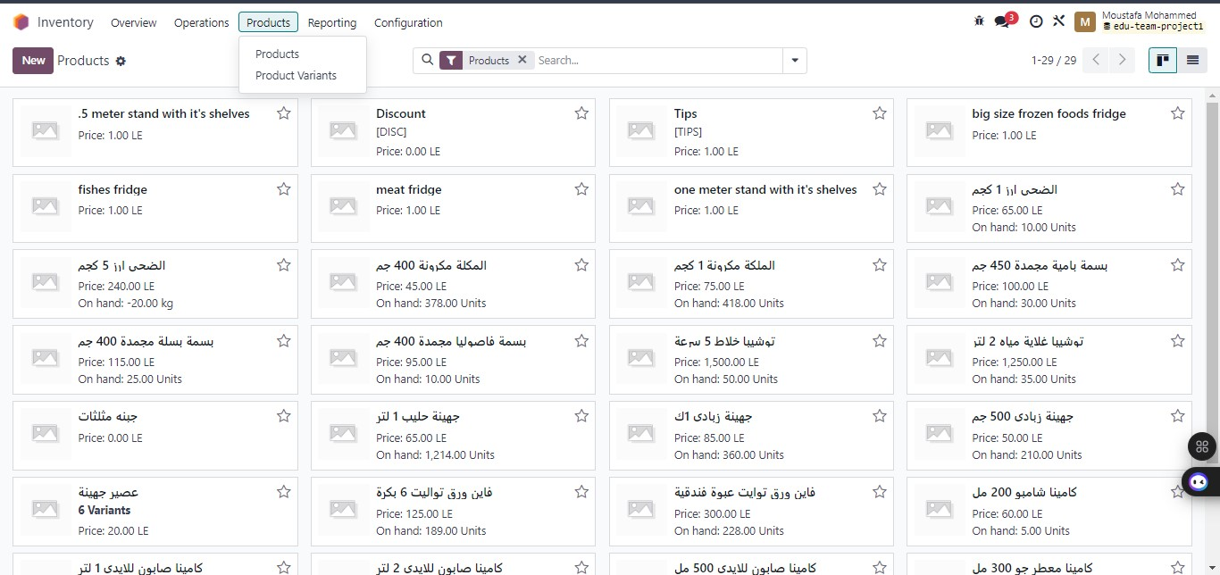
INVENTORY MODULE
Open Inventory then click on product to create new products

Slide 12
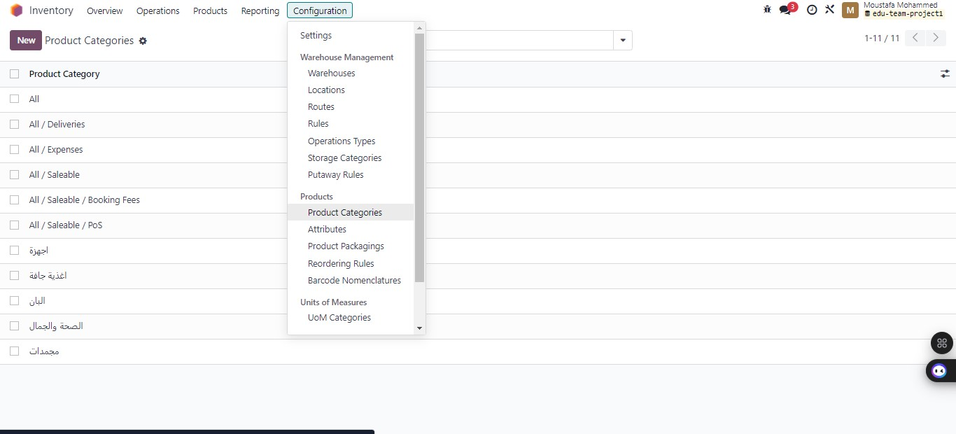
To define every product from configuration then select product category do identify every category

Slide 13
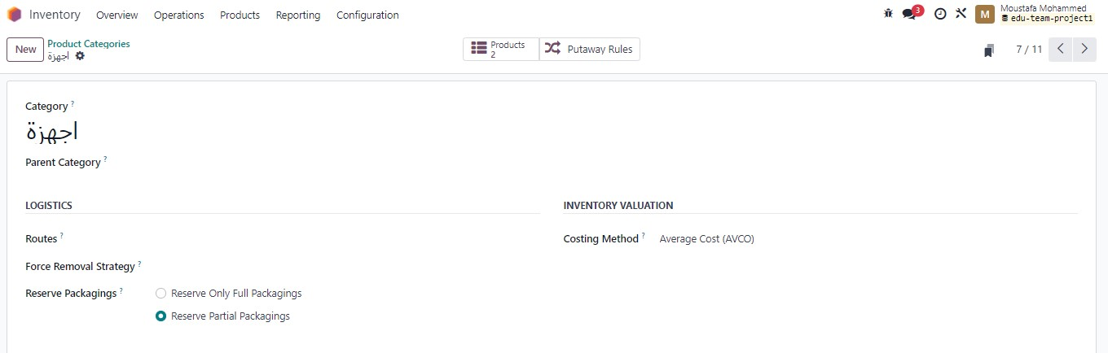
FROM INSIDE CATEGORY YOU CAN IDENTIFY WHICH STOCK VALUATION METHOD YOU USE

Slide 14
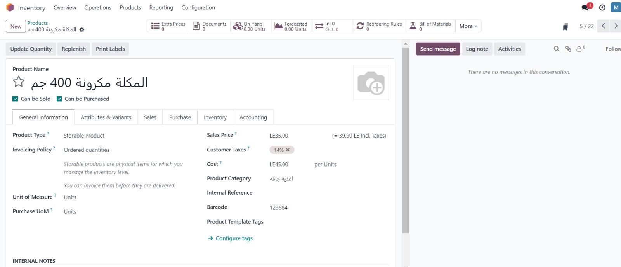
After creating products you can know the holistic information from product card

Slide 15
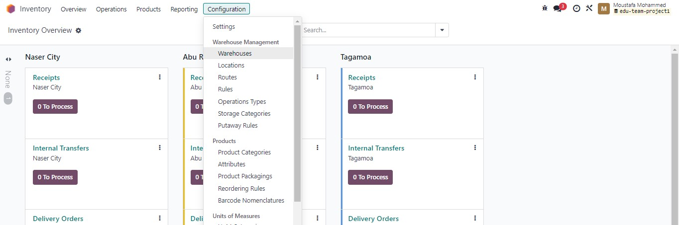
You can warehouses from configuration then select warehouse and put the informatioin

Slide 16
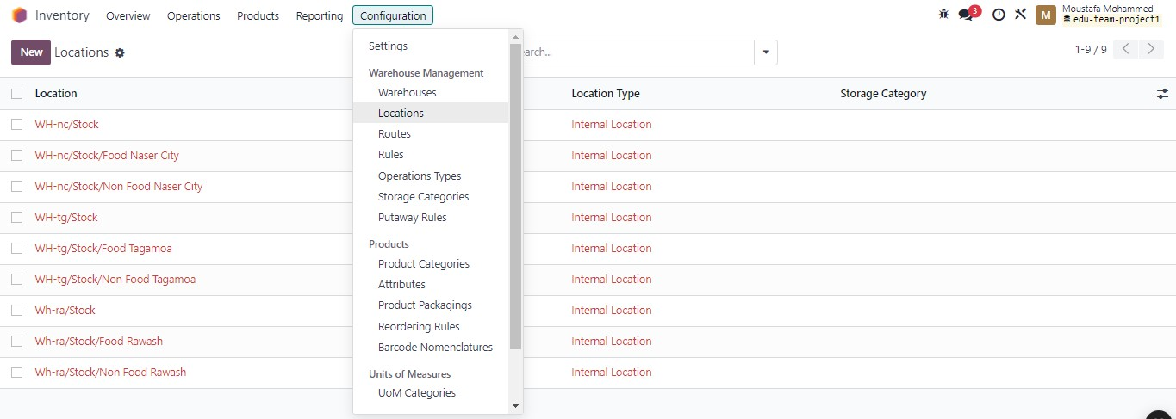
To identify the location of every warehouse and parent one

Slide 17
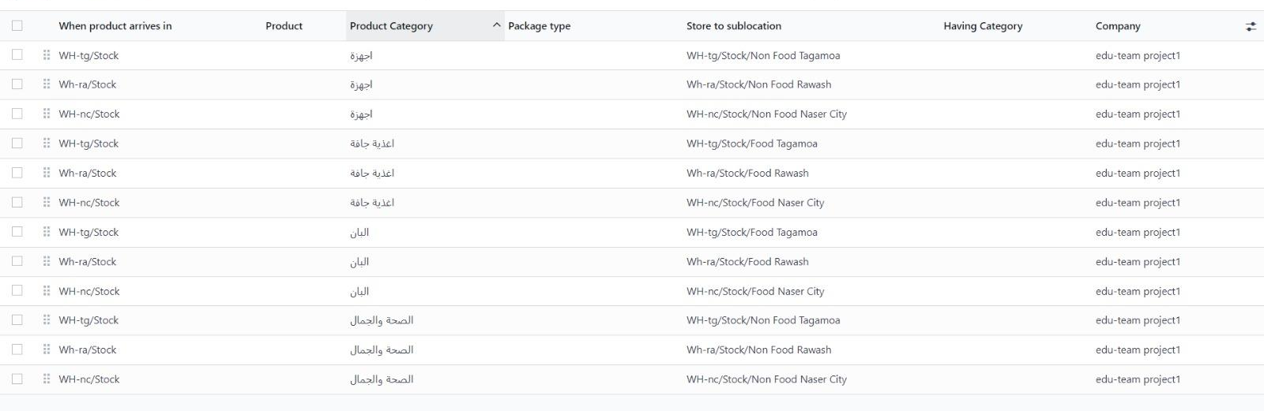
From Configuration Select Putaway Rules That Help To Enhance Inventory Efficiency, Accuracy, And Space Utilization In Warehouses.
But at First make sure that storage locations is activated from setting

Slide 18

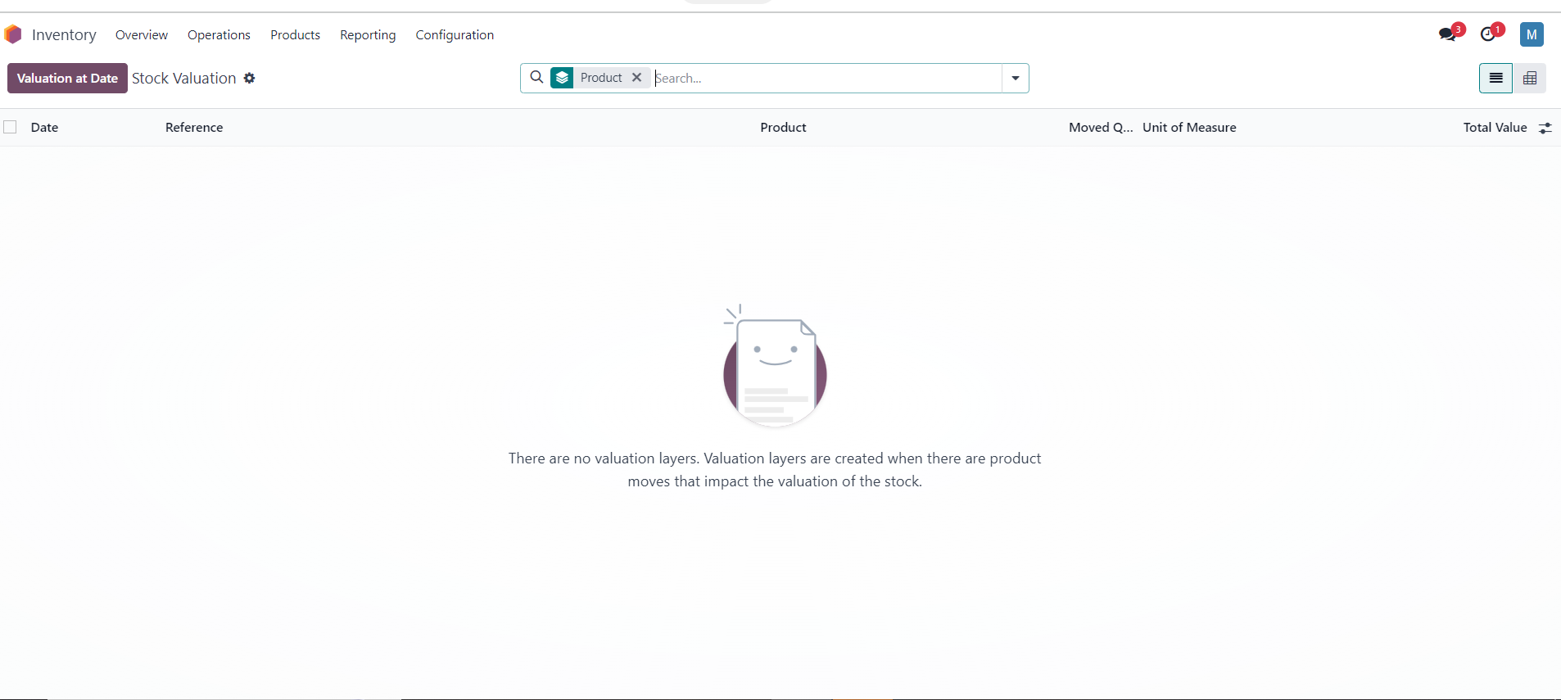
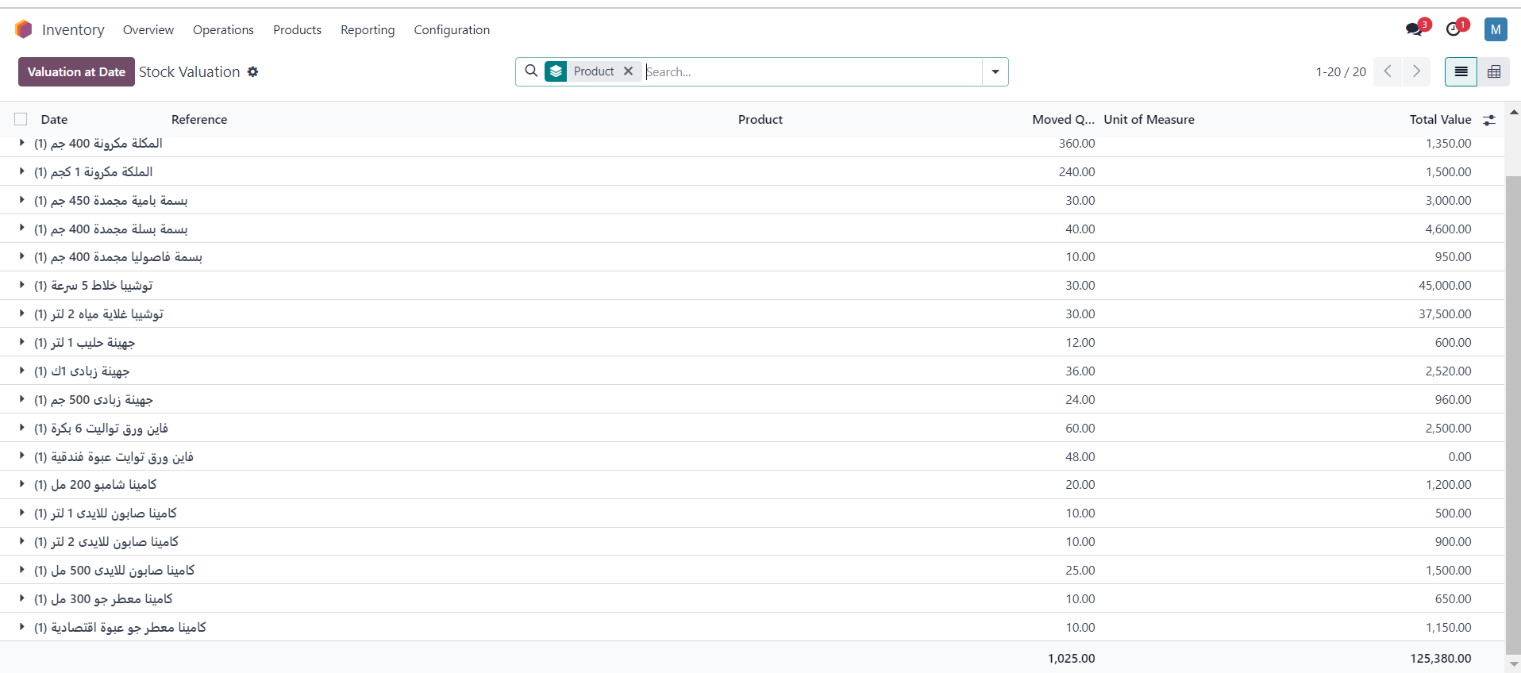
FROM REPORTING TAPE YOU CAN KNOW SOCK REPORT BEFORE AND AFTER RECEIVING

Slide 19
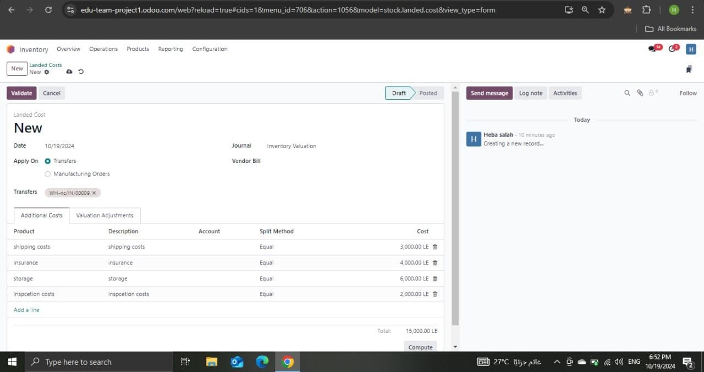
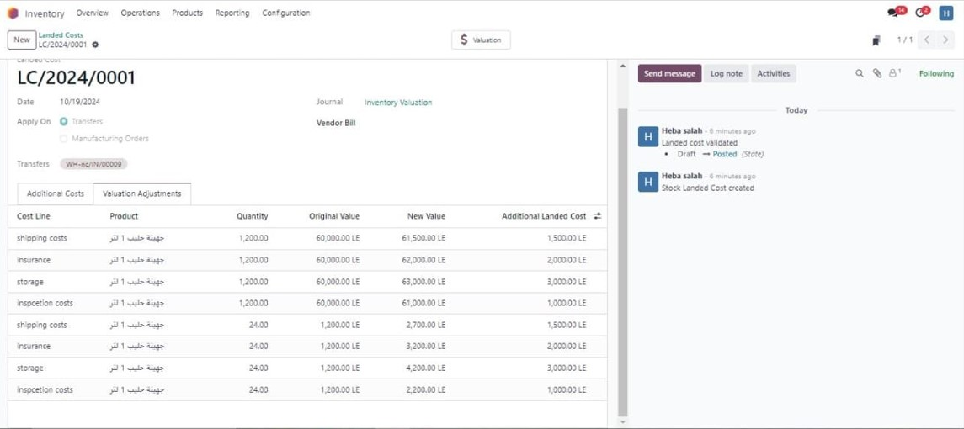
Using Landed Costs To Add Any Additional Costs On Puchases Like Shipping , Insurance Etc but you need to activate it from setting

Slide 20
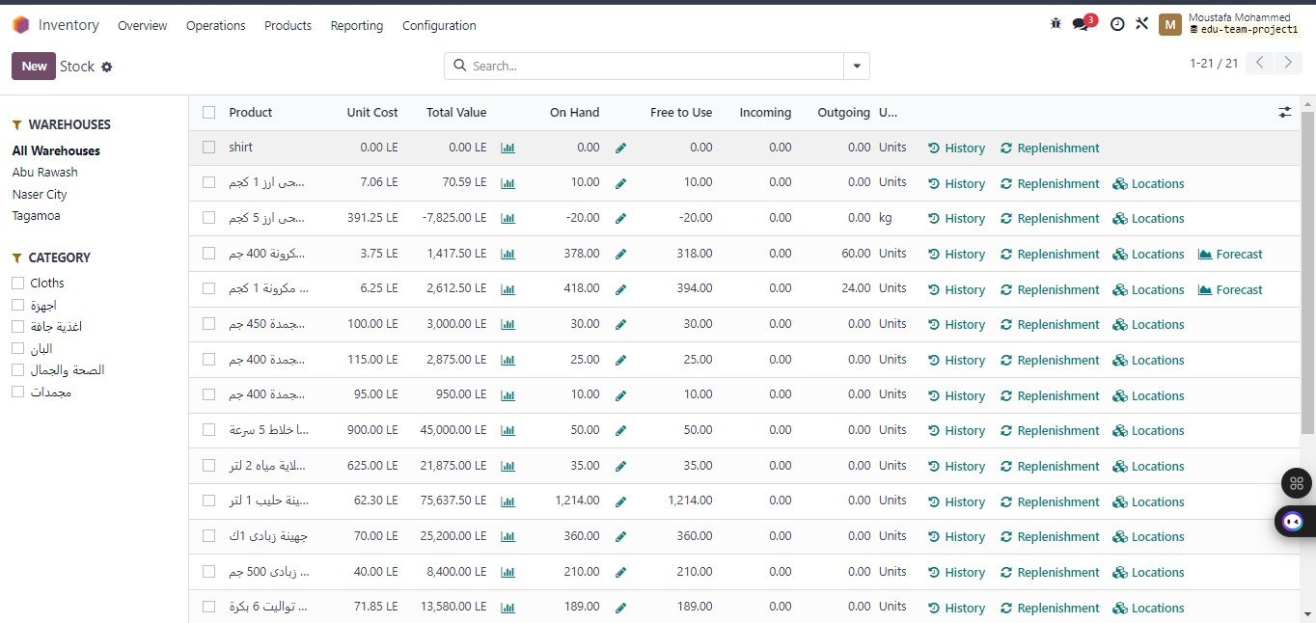
Stock Report

Slide 21
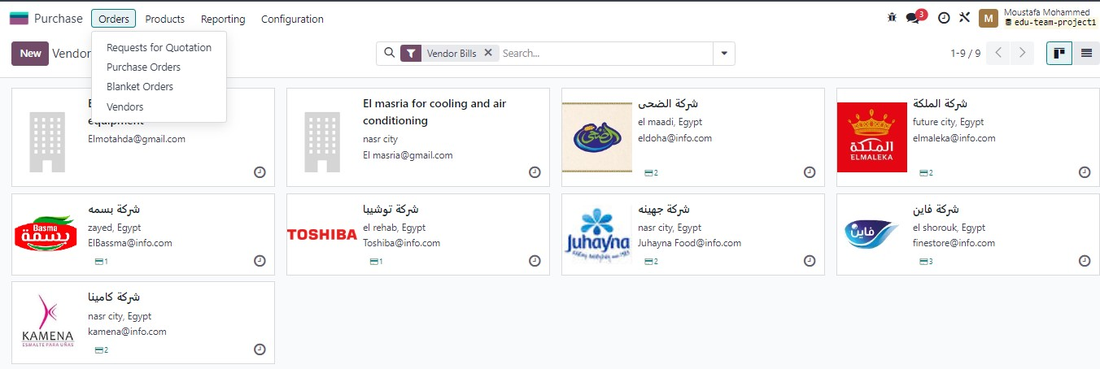
PURCHASE MODULE
From purchase app you can create vendors

Slide 22
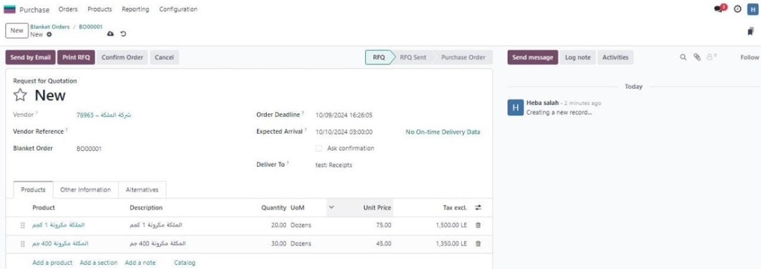
FOR GENERATING RFQ SELECT FROM ORDERS THEN YOU CAN CONFIRM IT OR NOT
Add vendor name

Slide 23
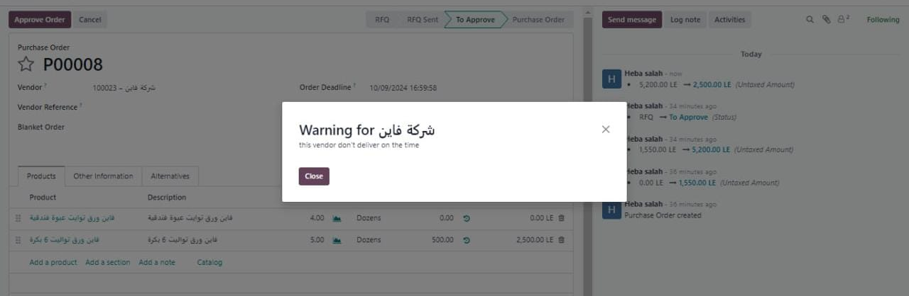
IF THE VENDOR NOT DELIVER ON TIME OR ANY ISSUE WE CAN MAKE WARNING TO ALARM EMPLOYEES

Slide 24
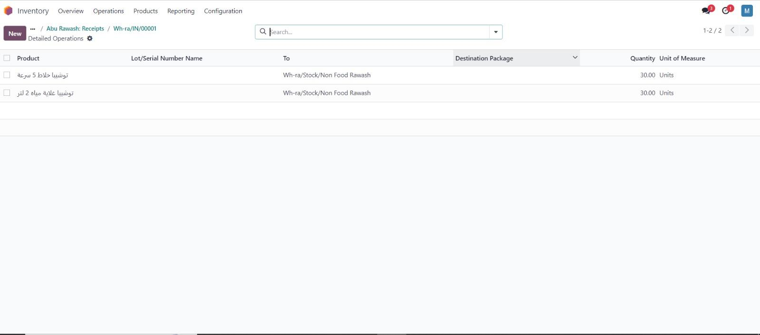
Putaway rules in purchase order to identify the accurate location in which the inventory will be stored

Slide 25
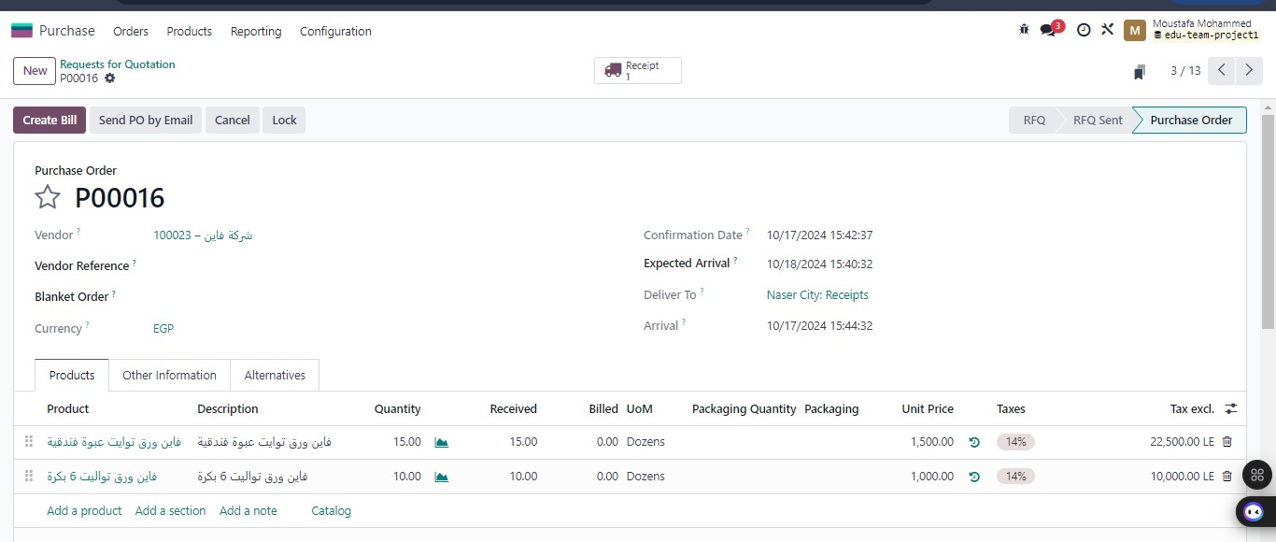
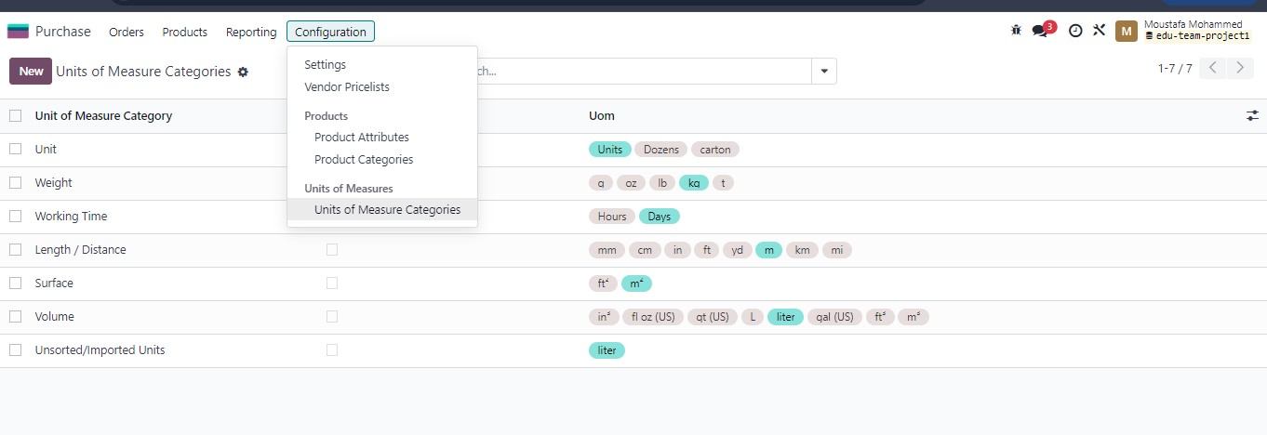
You can add new units of measure firstly from configuration select UOM categories then choose the category and define a new unit of measure

Slide 26
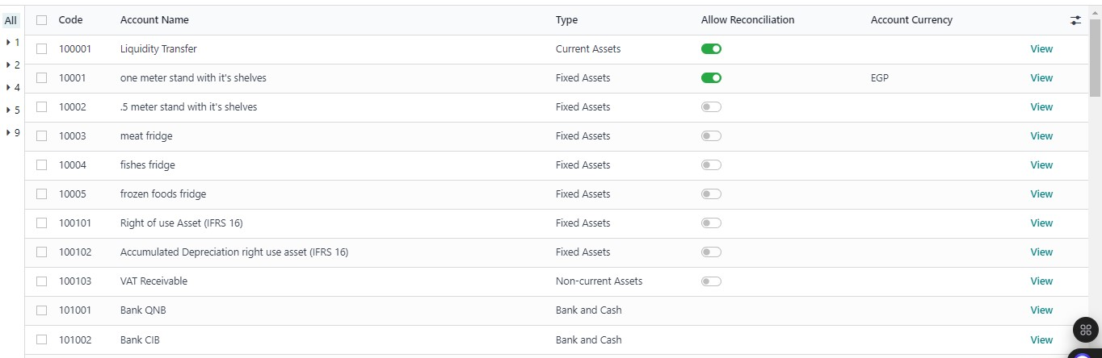
ACCOUNTING MODULE
From configuration COA we can create new accounts for Assets, Liabilities etc.……

Slide 27
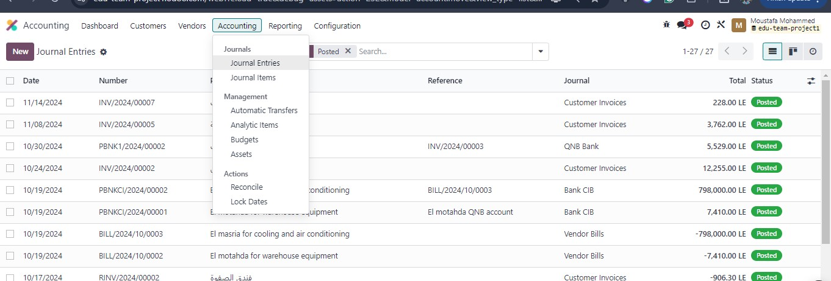
To Record Journal Entries From Accounting Tape Chose Journal Entries Then New And Insert Your Entry

Slide 28
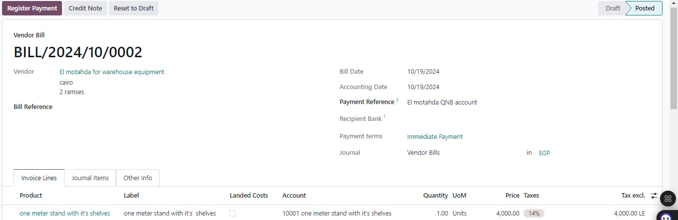
WHEN ADDING NEW ASSETS
We select from inside the ill create in draft to generate automatically and add it

Slide 29
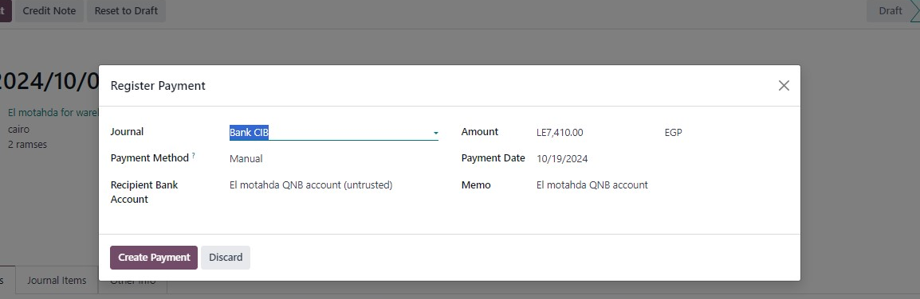
ADDING BANK ACCOUNTS
From configuration select add bank account or from journals

Slide 30
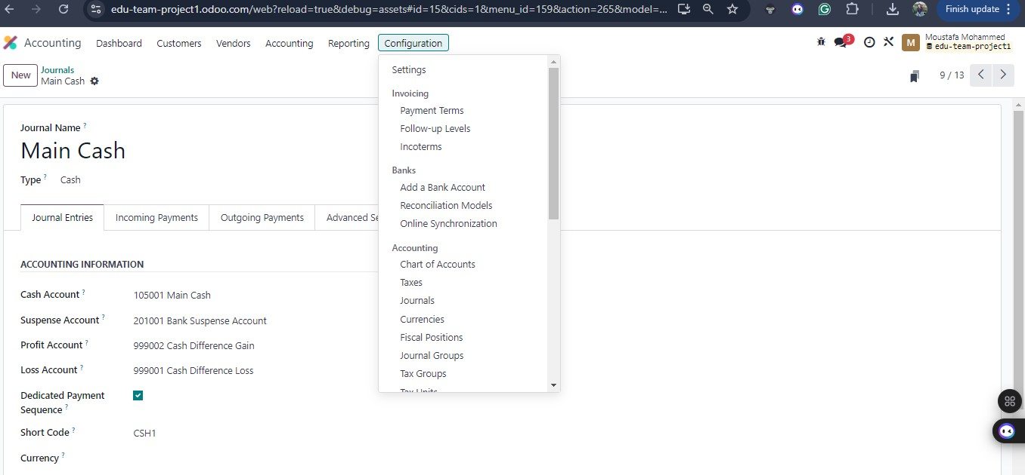
To Create Treasury Account From Accounting Tape Choose Journals Then New And Finally Add The Ine Account Information

Slide 31
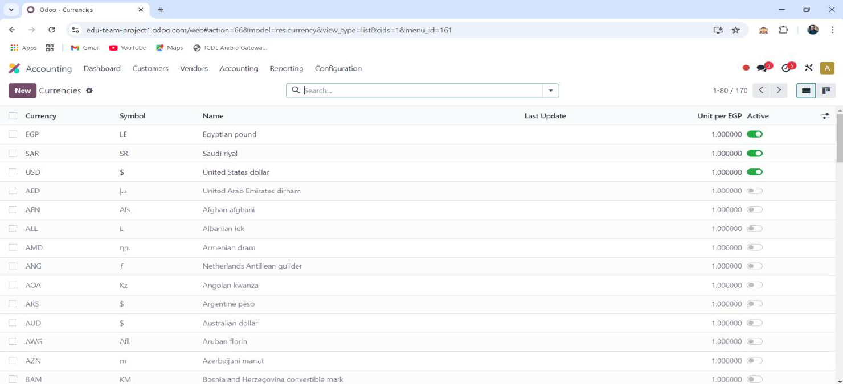
Multiple Currencies

Slide 32
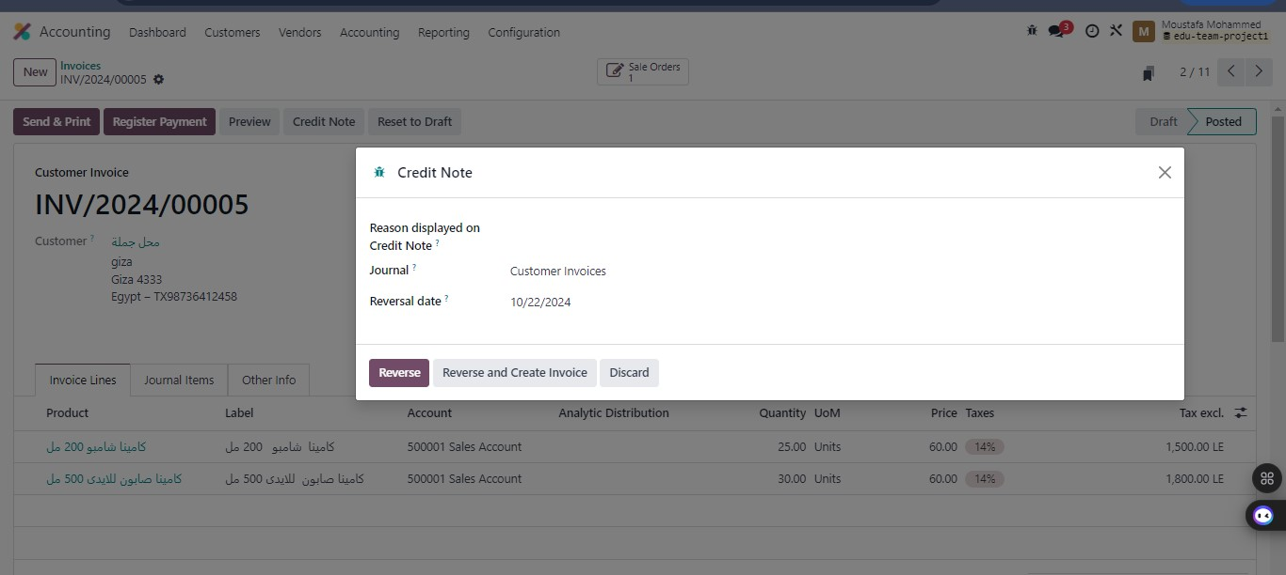
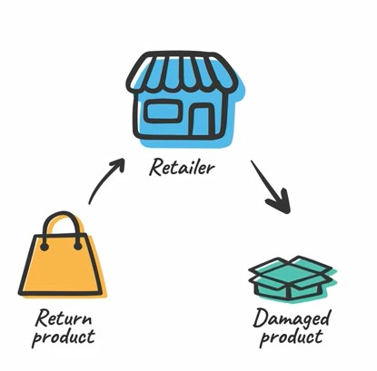
A credit note in Odoo ERP is a document that reduces a customer's debt due to returns, overcharges, or billing corrections.

Slide 33
A Credit Note In Odoo ERP Is A Document That Reduces A Customer's Debt Due To Returns, Overcharges, Or Billing Corrections. In Odoo ERP, The Credit Note Workflow Typically Involves The Following Steps: 1-Initiation: Customer Requests A Return Or Adjustment For Products Or Billing Errors. 2-Create Credit Note: Generate A Credit Note Directly From The Existing Invoice For Accuracy. 3-Validation And Approval: Review Details And Obtain Necessary Managerial Approval Before Finalizing. 4-Record Accounting Entries: Automatically Update Accounting Records To Reflect The Adjustment In Receivables. 5-Notify Customer: Send The Credit Note To The Customer, Ensuring Transparency And Documentation.

Slide 34
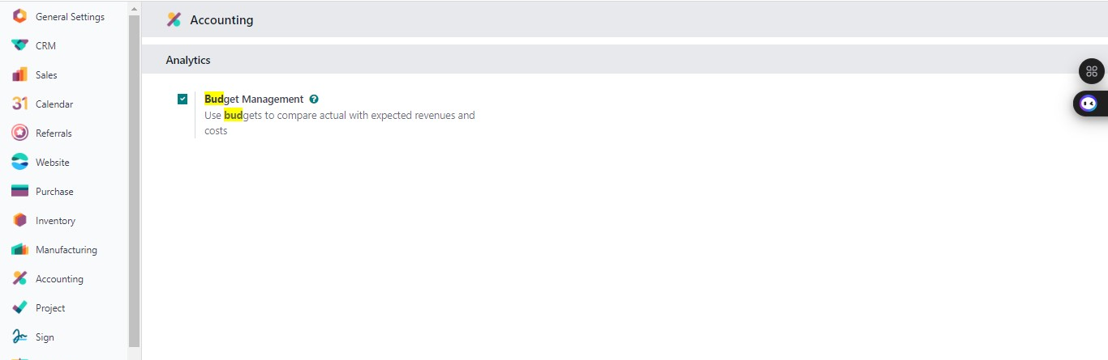
ACTIVATE BUDGET MANAGEMENT
To prepare budget monthly , quarterly ,annually and from accounting tape chose budget

Slide 35
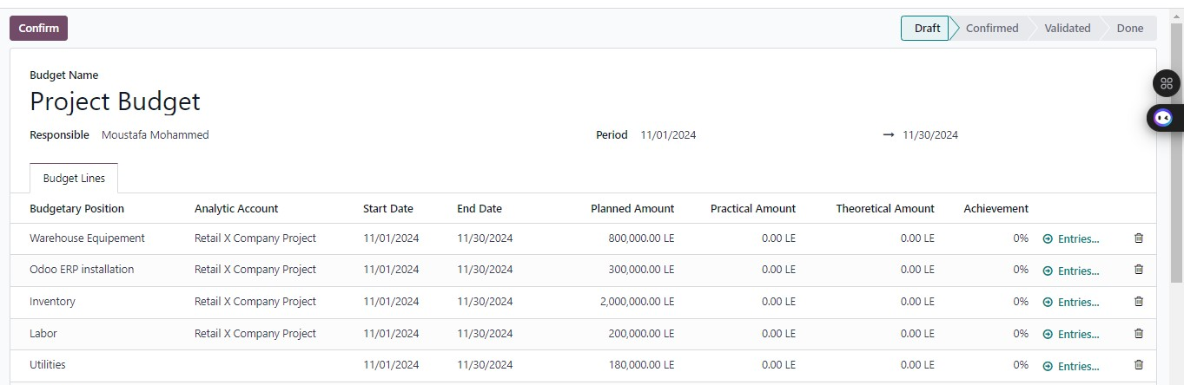
PROJECT BUDGET EXPENSE
Adding all elements of project expenses

Slide 36
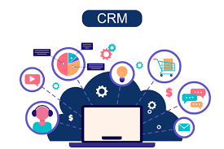
CRM Module

Slide 37
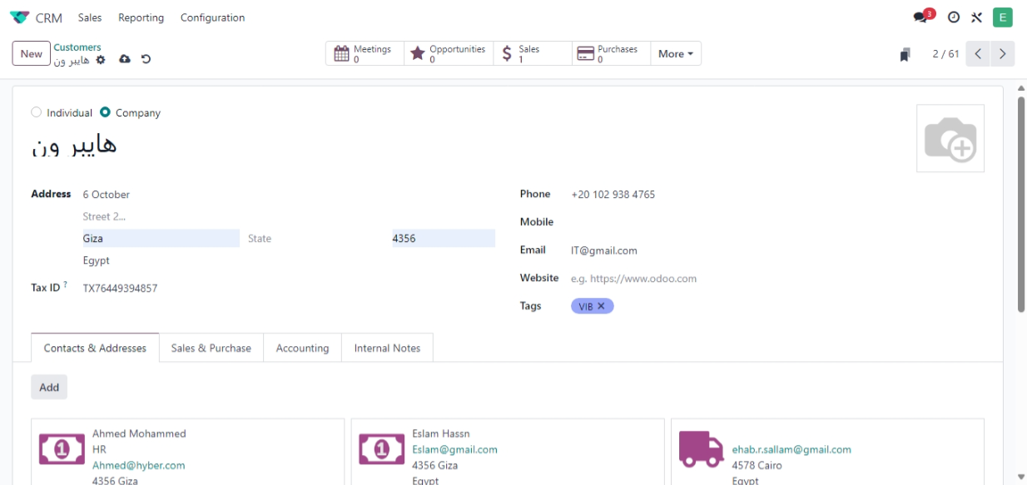
Create Customers By Click On Sales Tape Then Choose Customers

Slide 38
The CRM Cycle In Odoo ERP Typically Includes The Following Stages: 1-Lead Generation: Capture Potential Customers Through Various Channels Like Websites And Events. 2-Lead Qualification: Assess Leads To Determine Their Value And Readiness For Sales Engagement. 3-Opportunity Management: Convert Qualified Leads Into Opportunities, Tracking Interactions And Potential Deals. 4-Sales Activities: Manage Communications And Activities Related To Each Opportunity, Including Follow-ups And Meetings. 5-Closing The Sale: Finalize Transactions By Converting Opportunities Into Sales And Maintaining Post-sale Relationships.

Slide 39
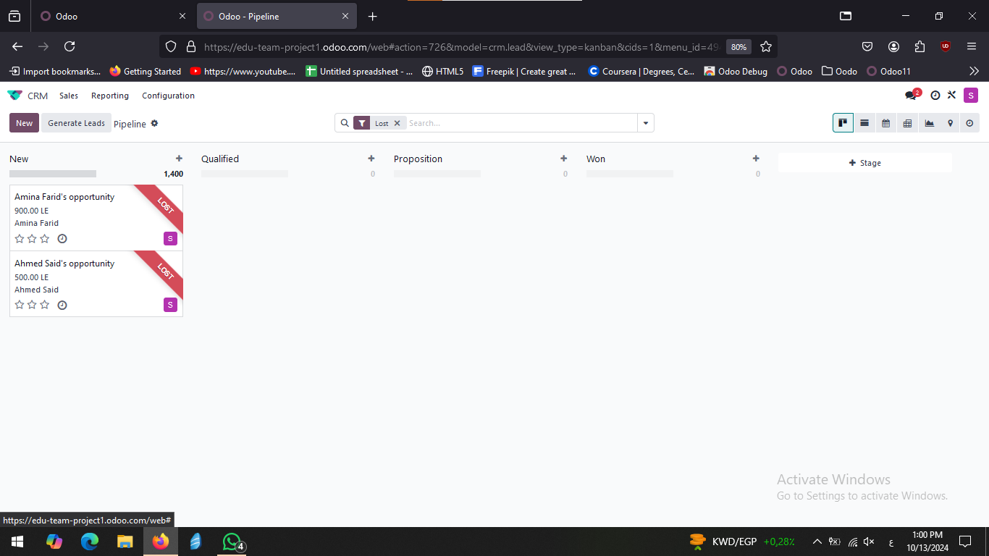
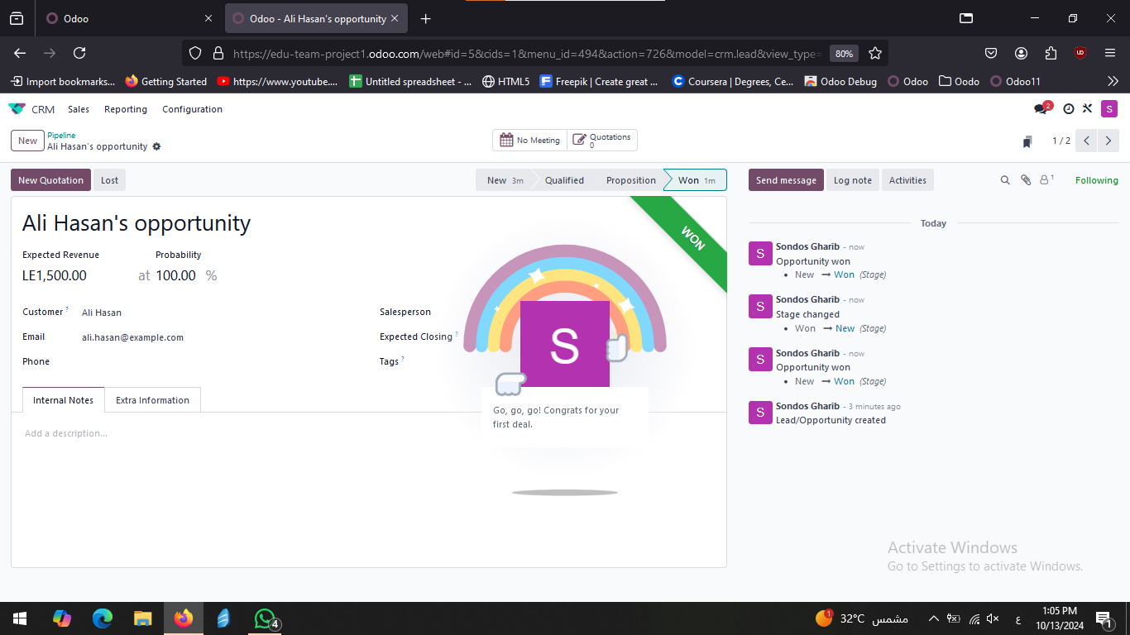

Slide 40
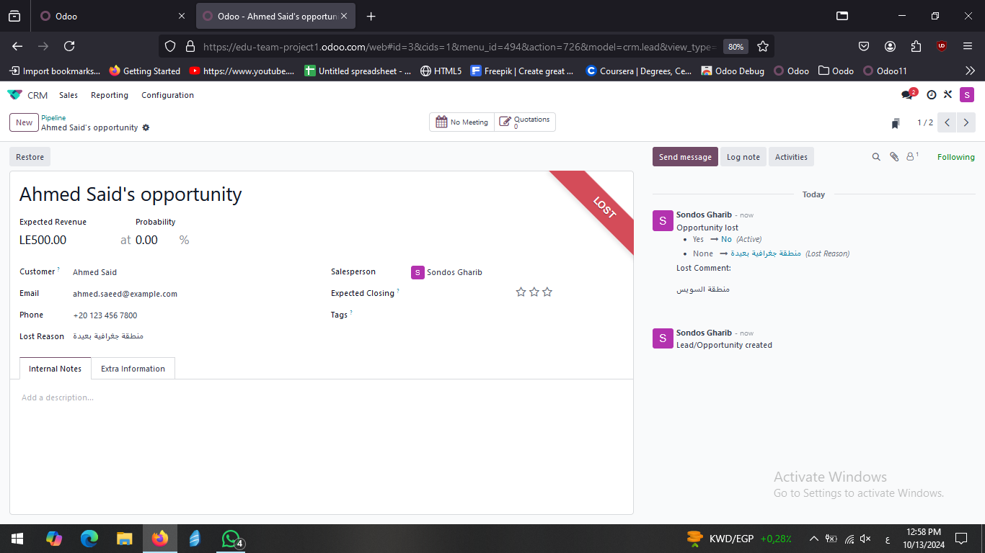
GENERATE LEADS THEN CONVERT TO LOST AND MENTION THE REASON

Slide 41
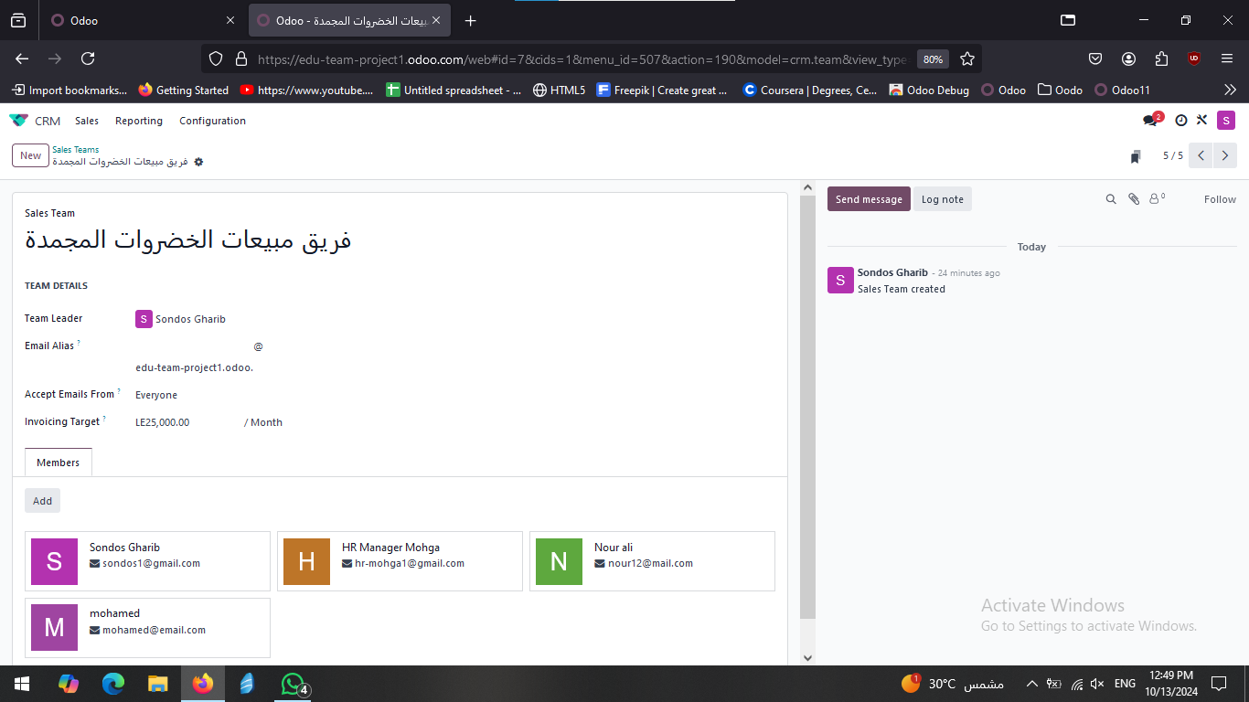
CREATE SALES TEAMS FOR SALES DEPARTMENT

Slide 42
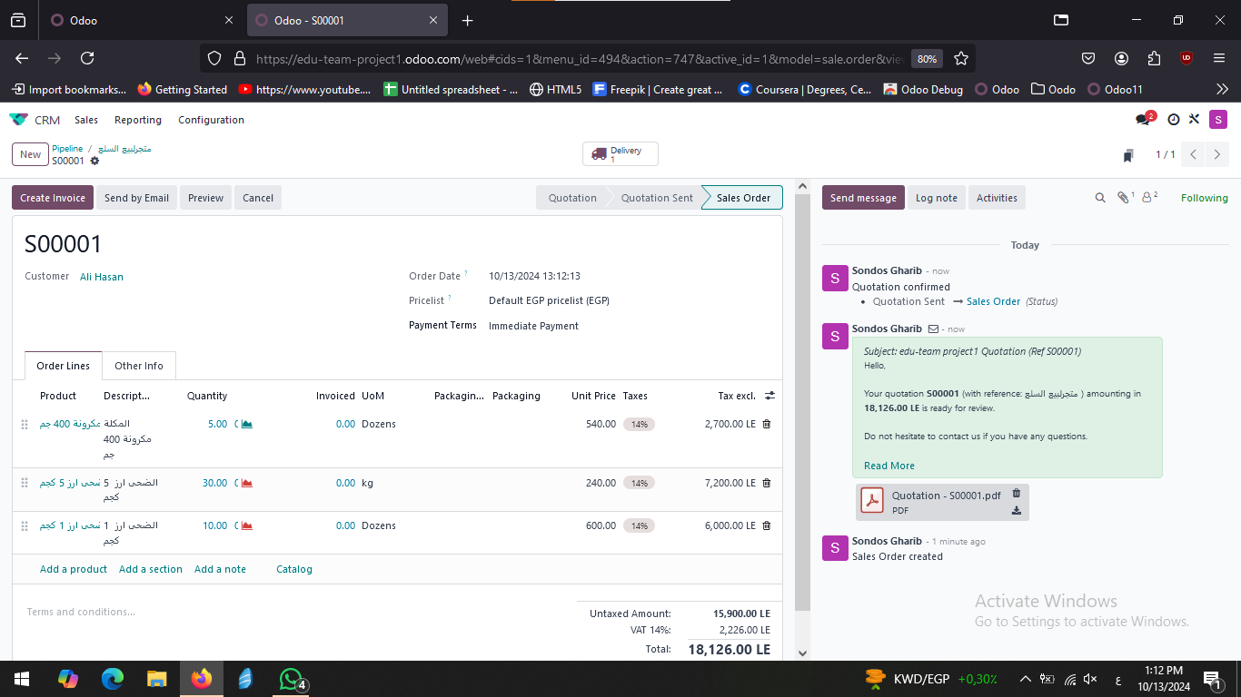
CREATE SALES QUOTATION FOR CUSTOMER

Slide 43
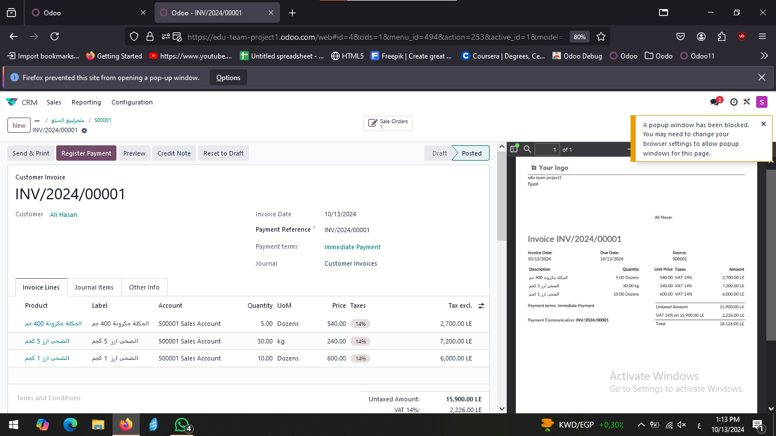
CREATE THE INVOCE AND SEND IT AFTER ACCEPTING THE QUATATION

Slide 44
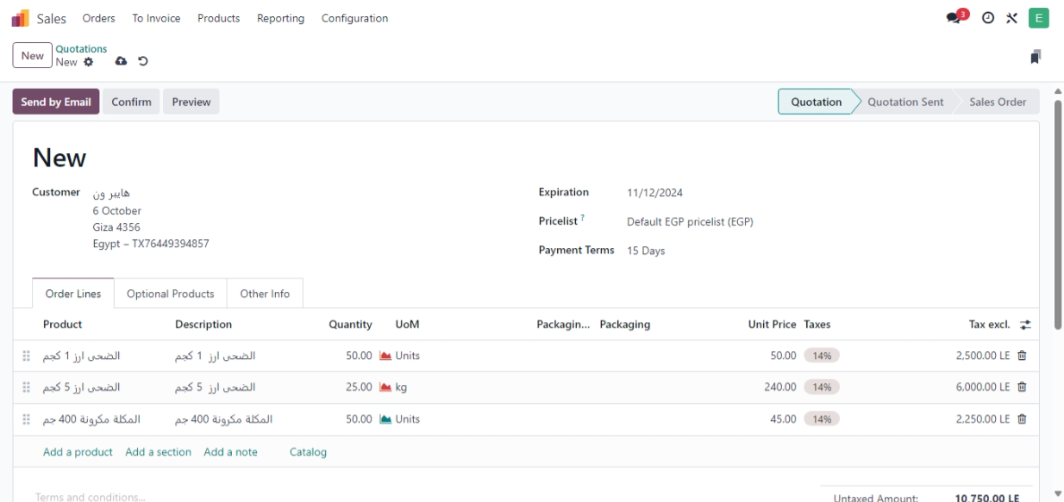
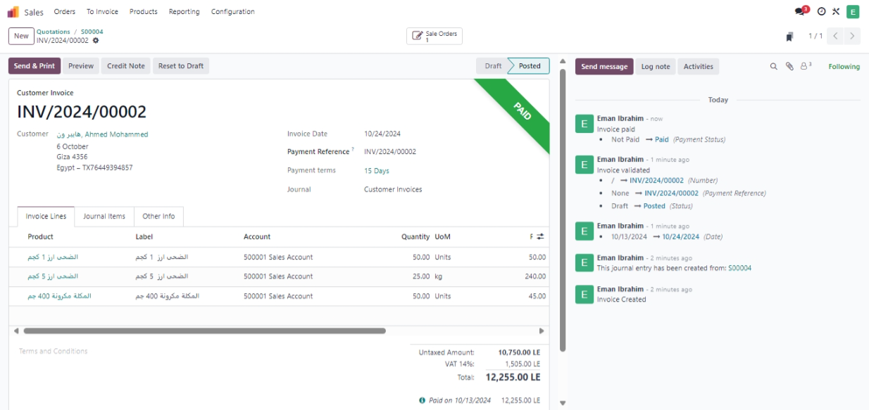
SALES MODULE
Open Sales Module Then Click New To Create Quotation and create the invoce

Slide 45
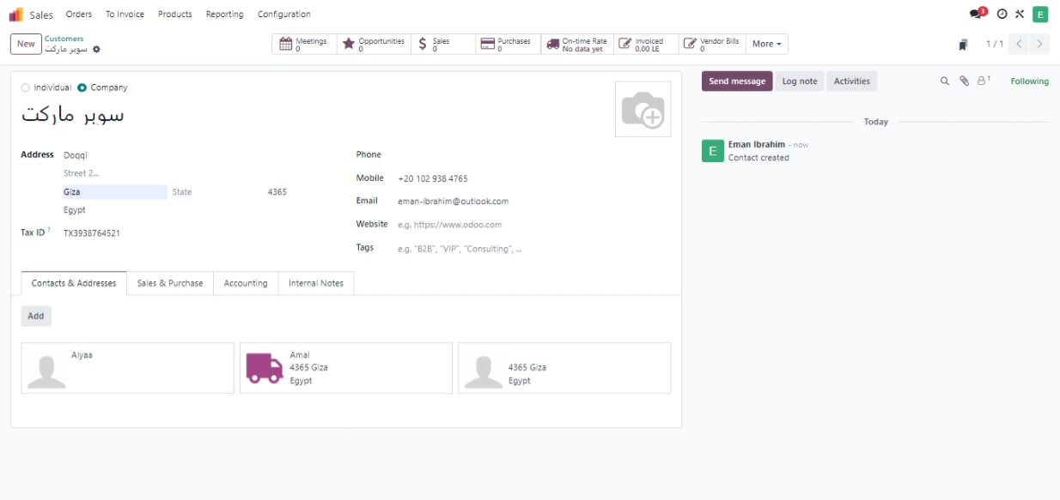
TO CREATE CUSTOMERS FROM ORDER TAPE SELECT CUSTOMERS

Slide 46
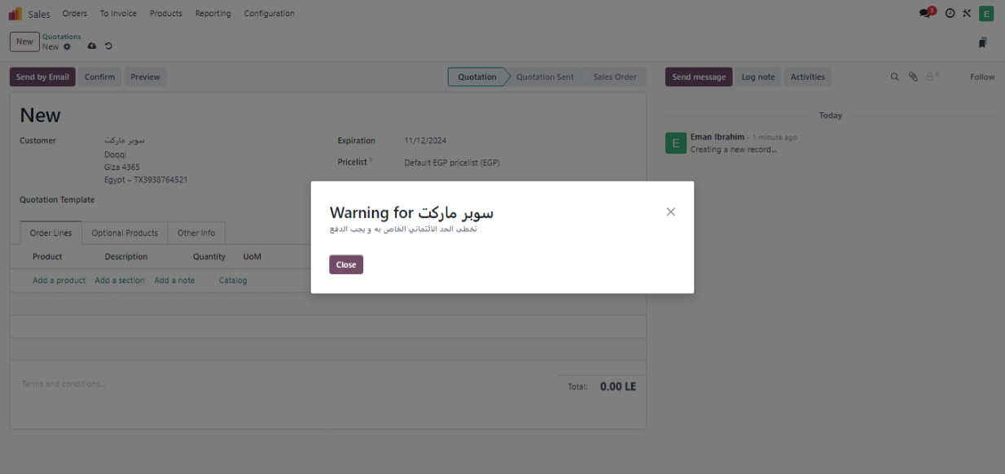
MAKING WARNING FOR CUSTOMERS CREDIT LIMIT

Slide 47
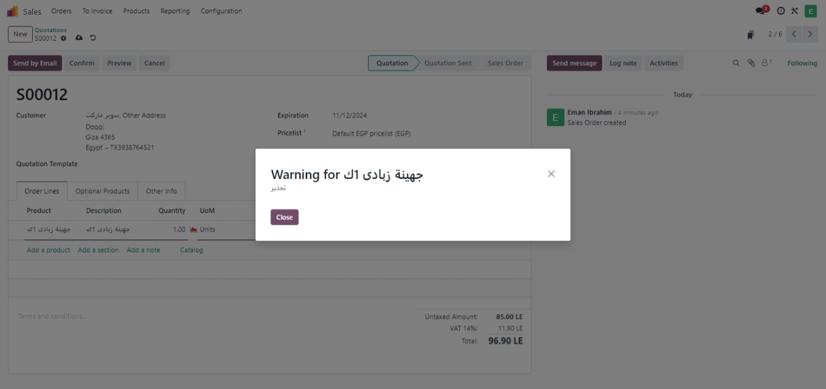
Warning For Product If There Is Stockout Or Any Issue Mention It In The Warning

Slide 48
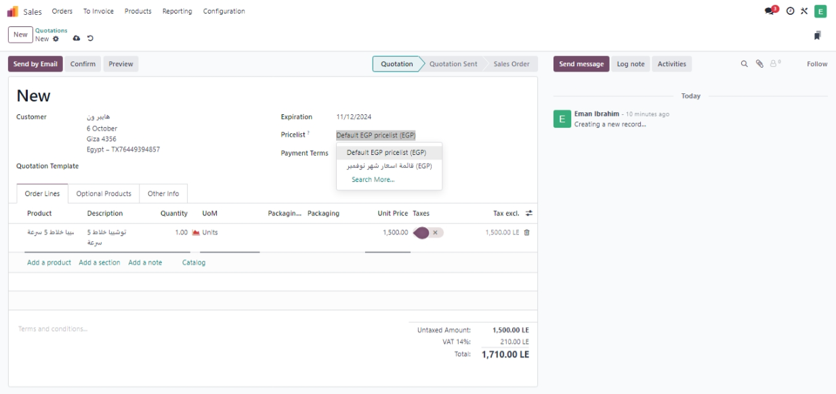
Create A Specific Pricelist In The System

Slide 49
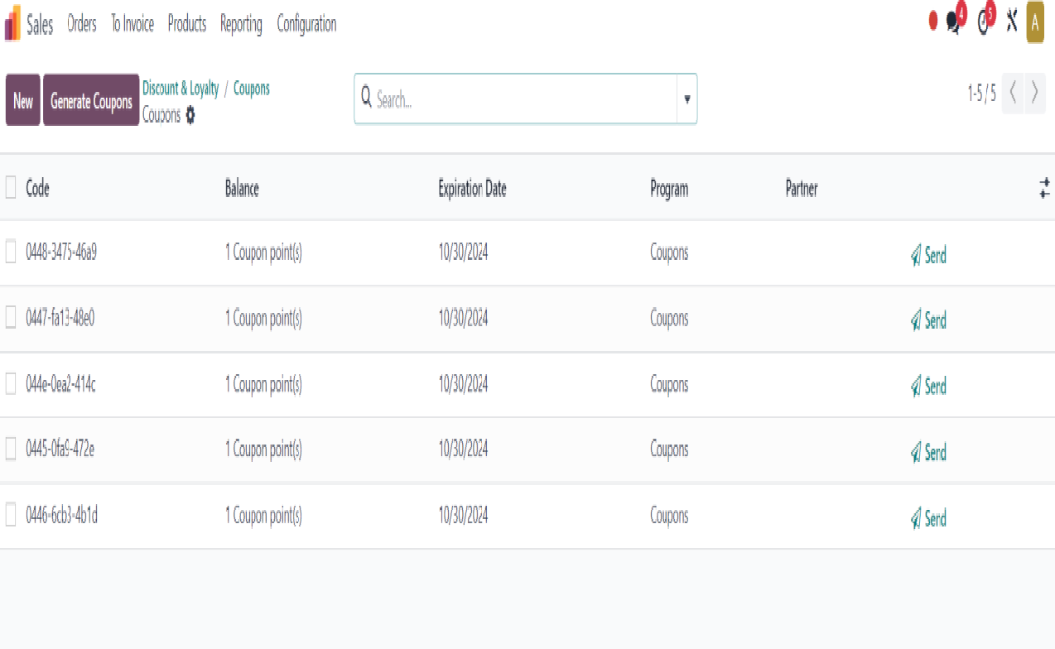
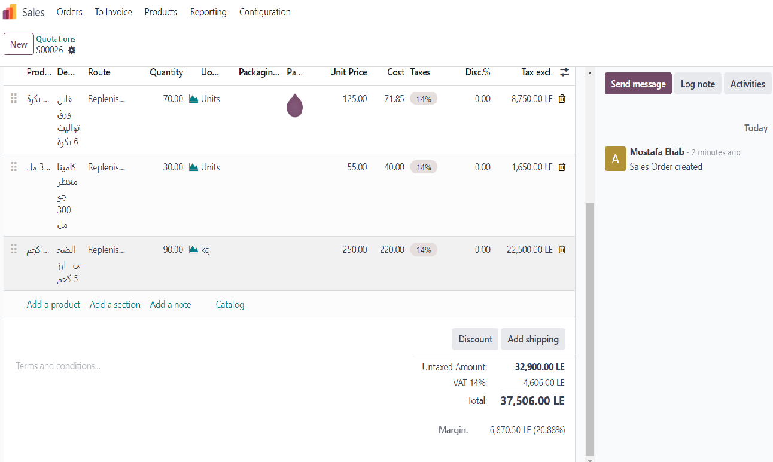
Activate Coupons And Discounts From Sales Setting Discounts, Loyalty & Gift Card to generate coupons and discounts

Slide 50
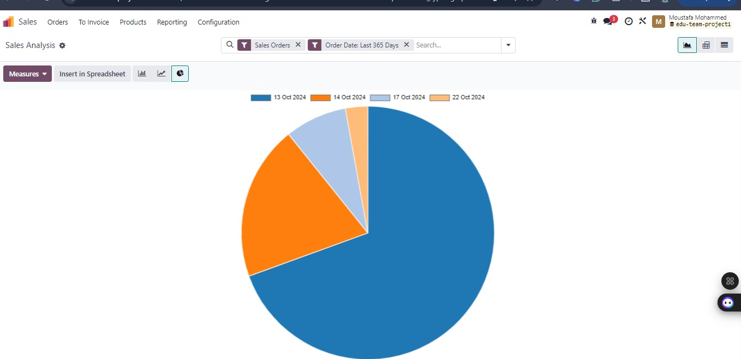
SALES ANALYSIS REPORT

Slide 51
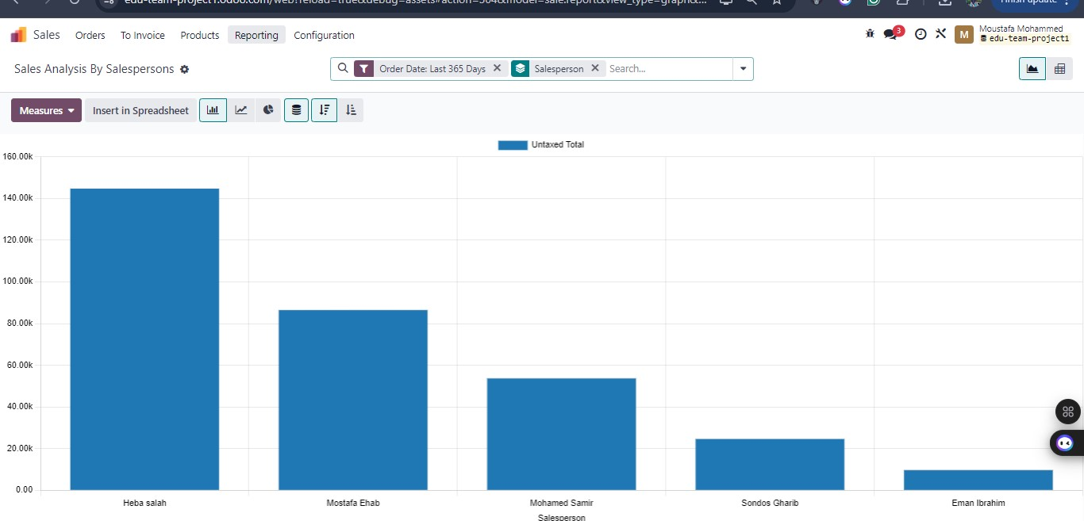
Sales Analysis By Salespersons Report

Slide 52
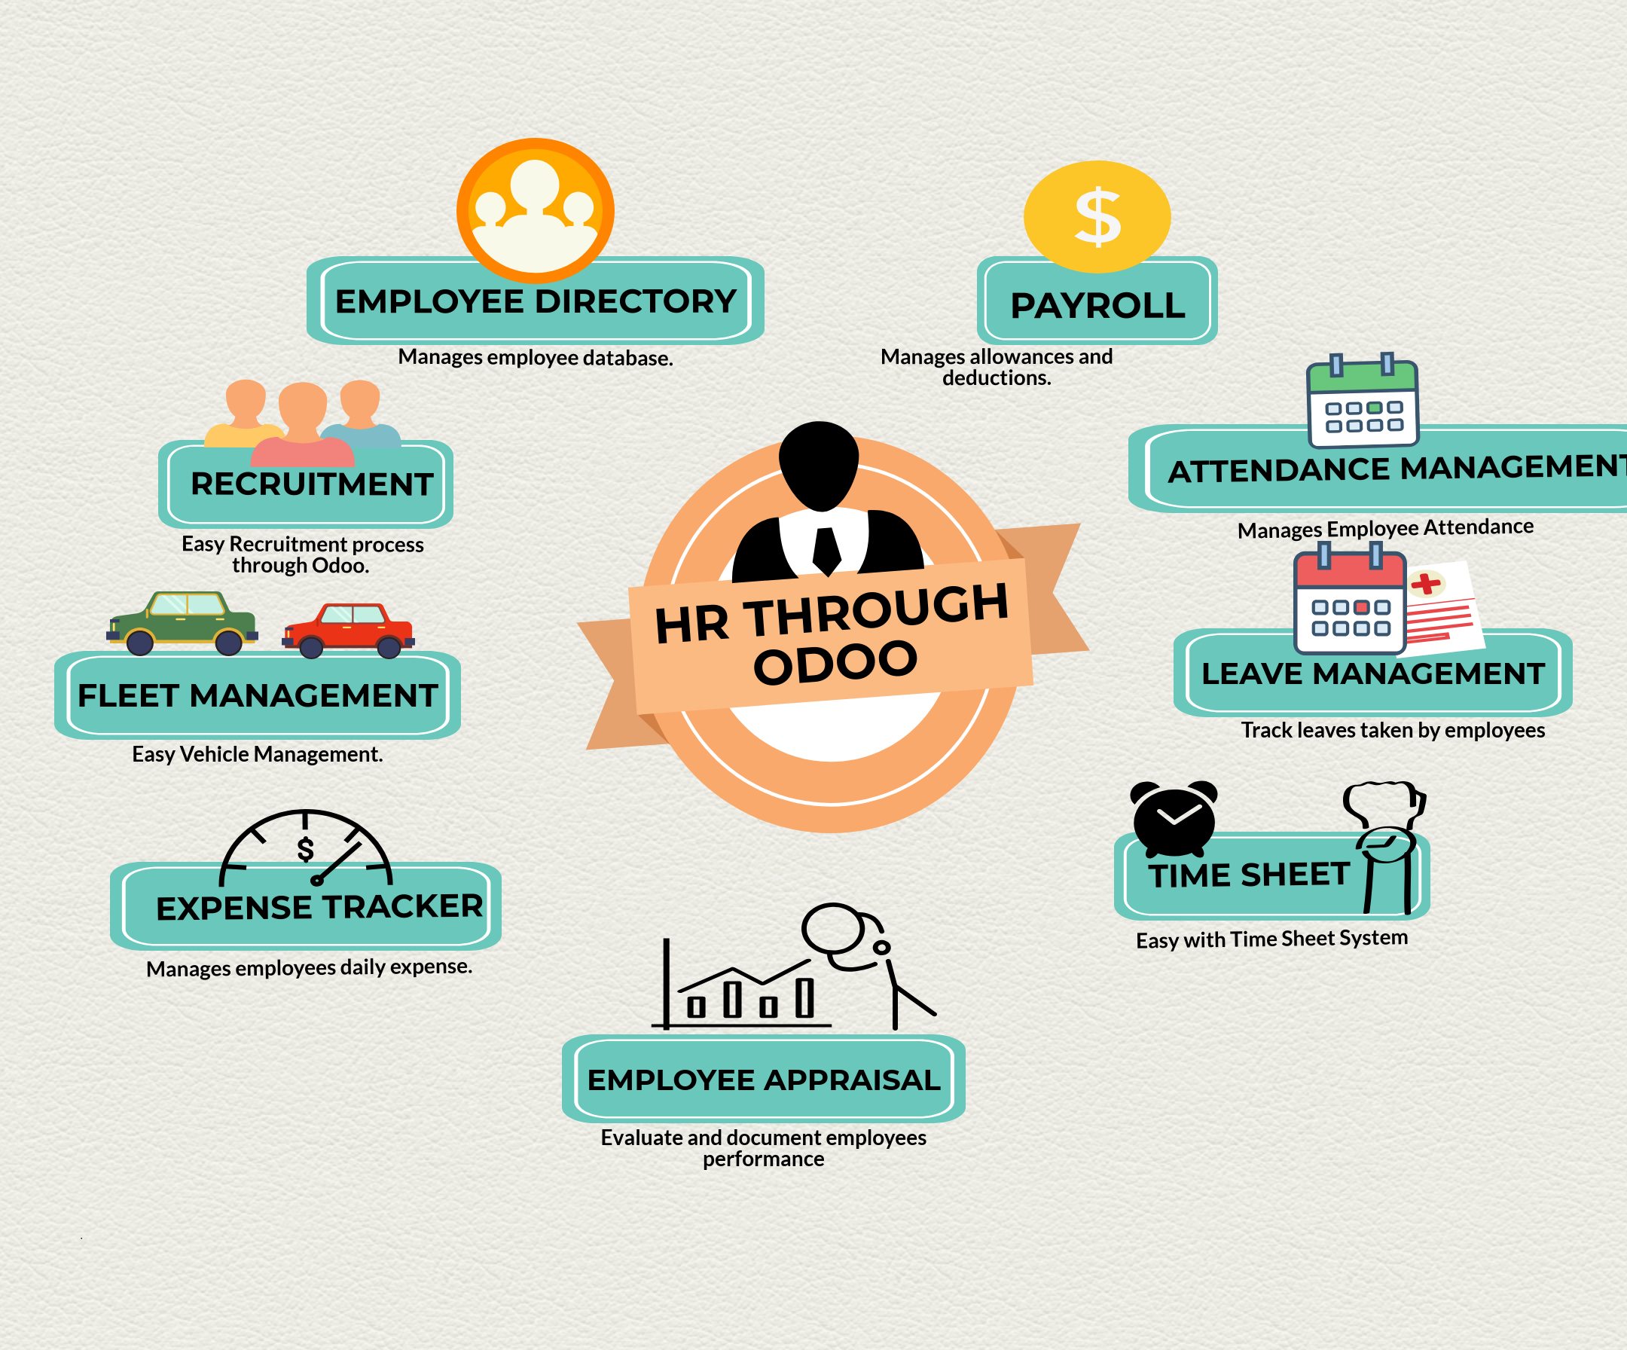
HR MODULES

Slide 53
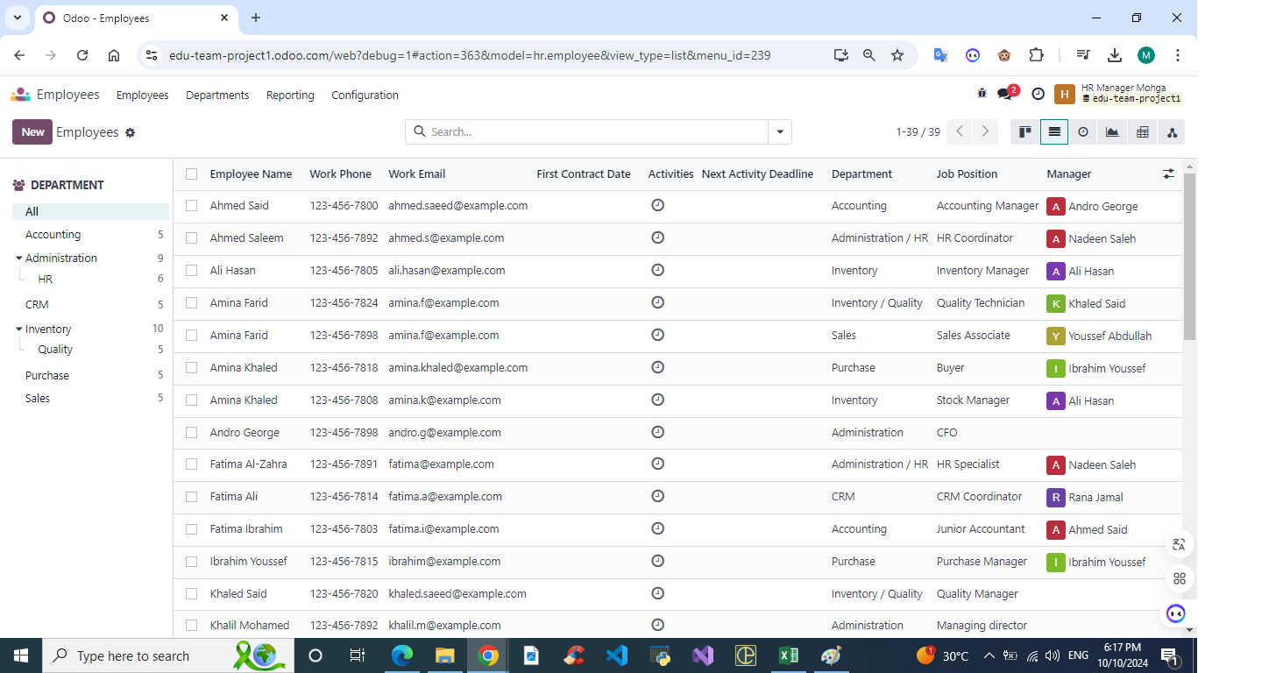
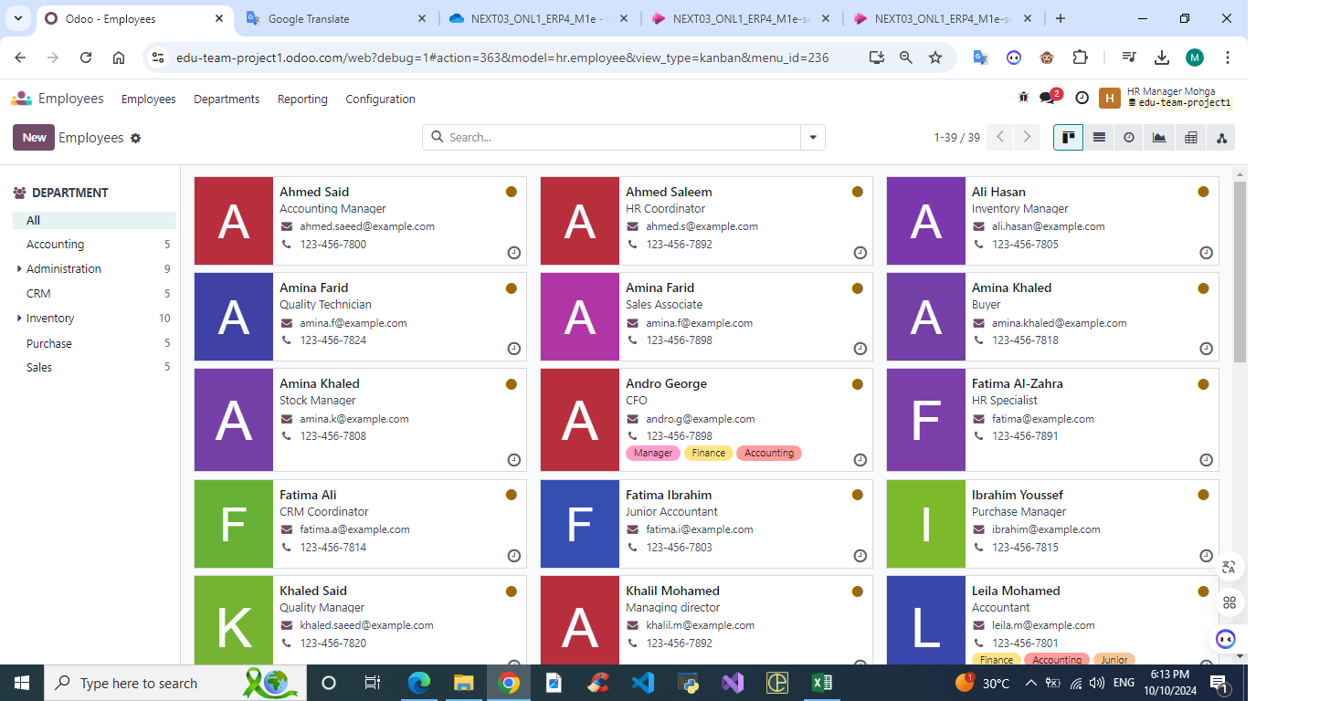
Employees List View
Employees Kanban view

Slide 54
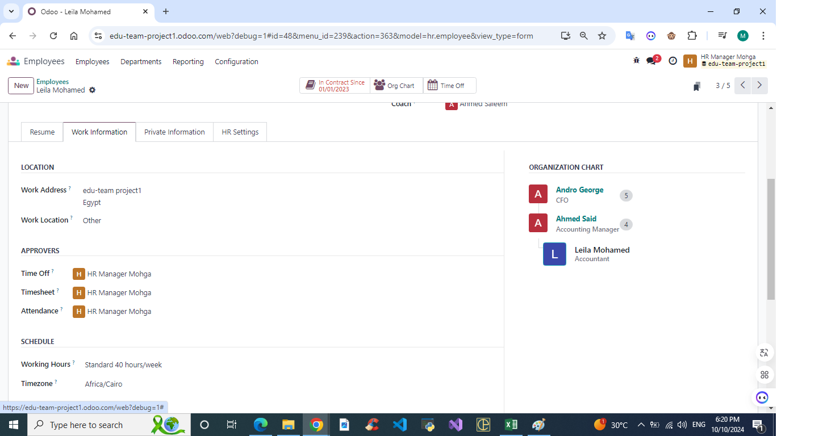

Emp – Work Information
Employee Resume Section

Slide 55


Employee’s ORG Chart Sample
Job Positions

Slide 56


Employee From Inside
Employees skills

Slide 57


Departments

Slide 58


Application Stages
Recruitment

Slide 59


Hiring Positions
Hiring from the Company’s web site

Slide 60


Rejection Reasons
Requirements and skills

Slide 61


Time Off Accrual Plan

Slide 62



Employees Allocations
Creating a time off for employee
Time off days waiting the approval

Slide 63




SAMPLE OF EMPLOYEE TIME OFF AVAILABLE DAYS
Public Holidays
Time off type
Mandatory days that the employee can’t take it as a time off

Slide 64



EMPLOYEE CONTRACTS SAMPLE
Employee payslip from inside
Salary structure

Slide 65

ATTENDANCE SAMPLE

Slide 66



QUALITY CONTRO POINTS
Quality Checks

Slide 67

Pass or fail

Slide 68


Slide 69

Thank you

